Slide 1




End-to-end Case-based Reasoning for Commonsense Knowledge Base Completion
Zonglin Yang, Xinya Du, Erik Cambria, Claire Cardie
Paper: https://aclanthology.org/2023.eacl-main.255.pdf
Code: https://github.com/ZonglinY/ECBRF_Case_Based_Reasoning_with_PLM

Slide 2
One-sentence Contribution
We show the connection between in-context demonstration and a classic AI subject named Case-based Reasoning, and that bridging them is beneficial to both fields (NLP and Case-based Reasoning).

Slide 3
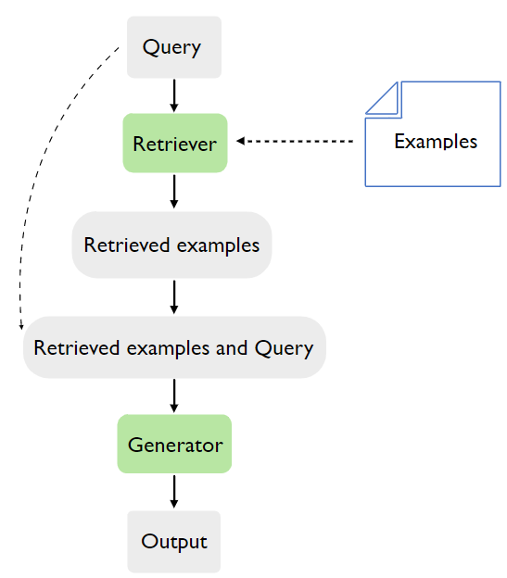
In-context Demonstration

Slide 4
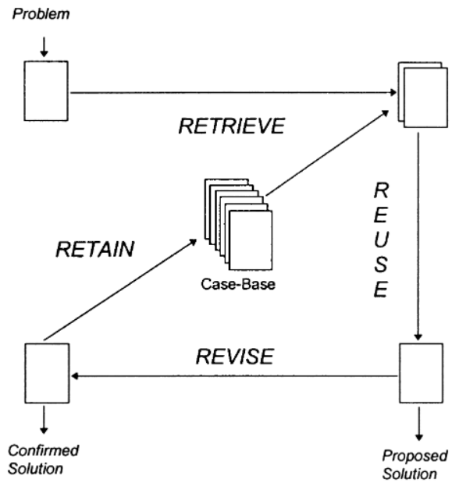
Case-based Reasoning

Slide 5
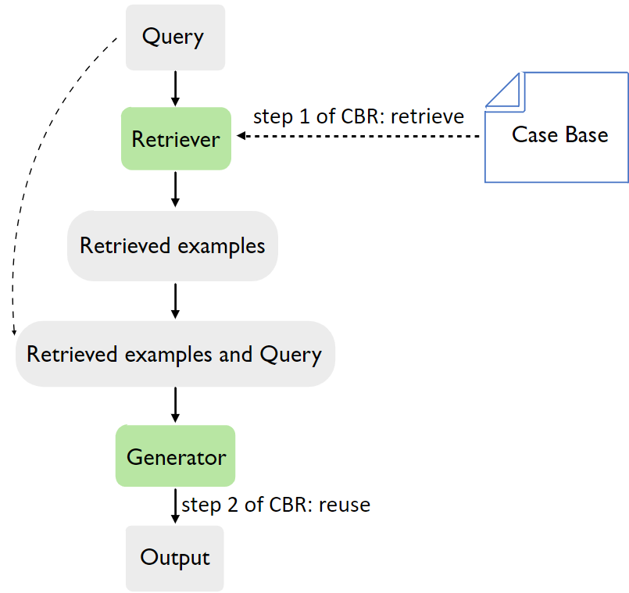
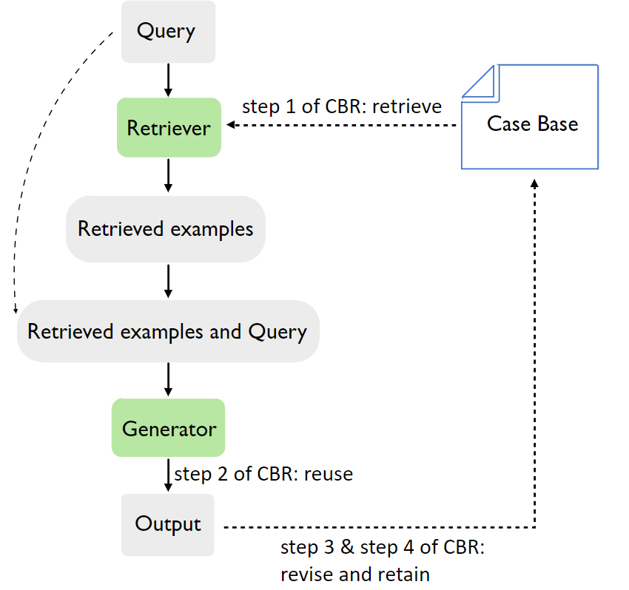
In-context demonstration in a case-based reasoning (CBR) perspective
End-to-end Case-Based Reasoning Framework (ECBRF)

Slide 6
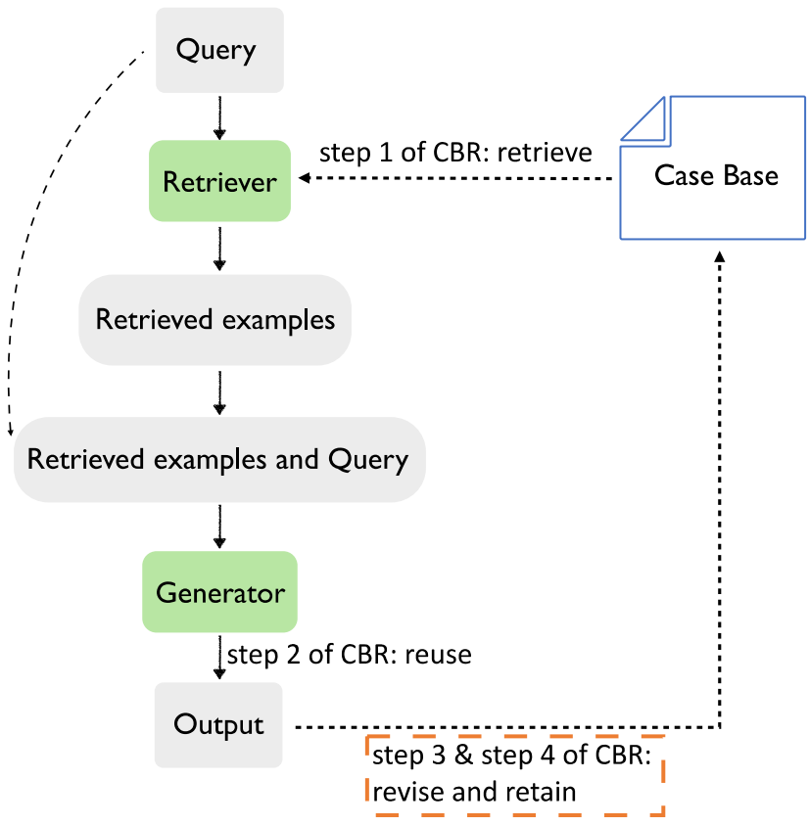
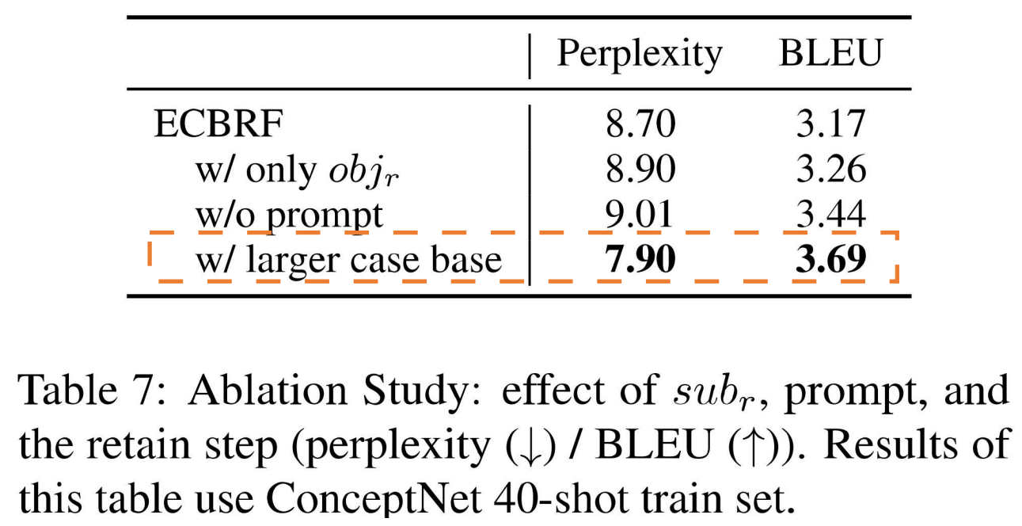
Benefits to NLP (1): Retain

Slide 7
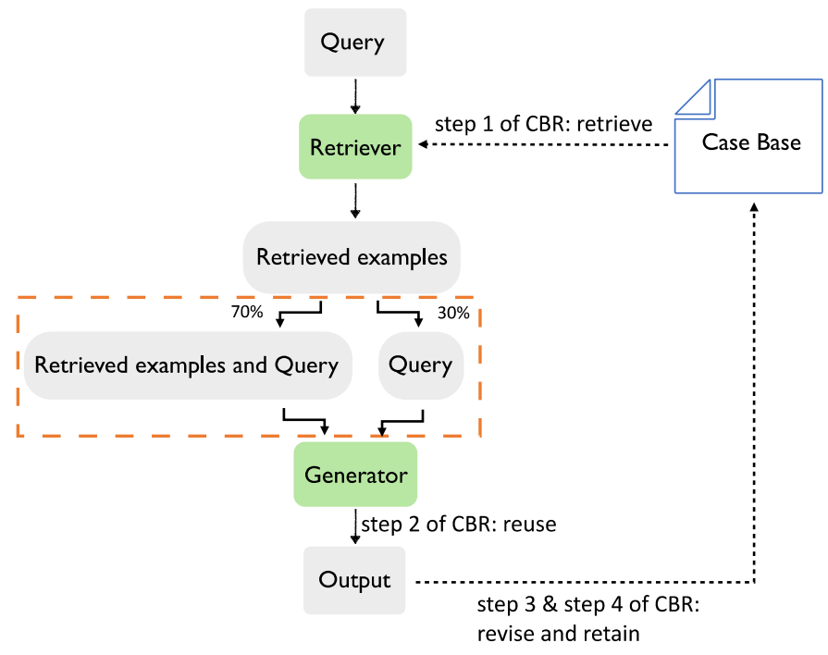
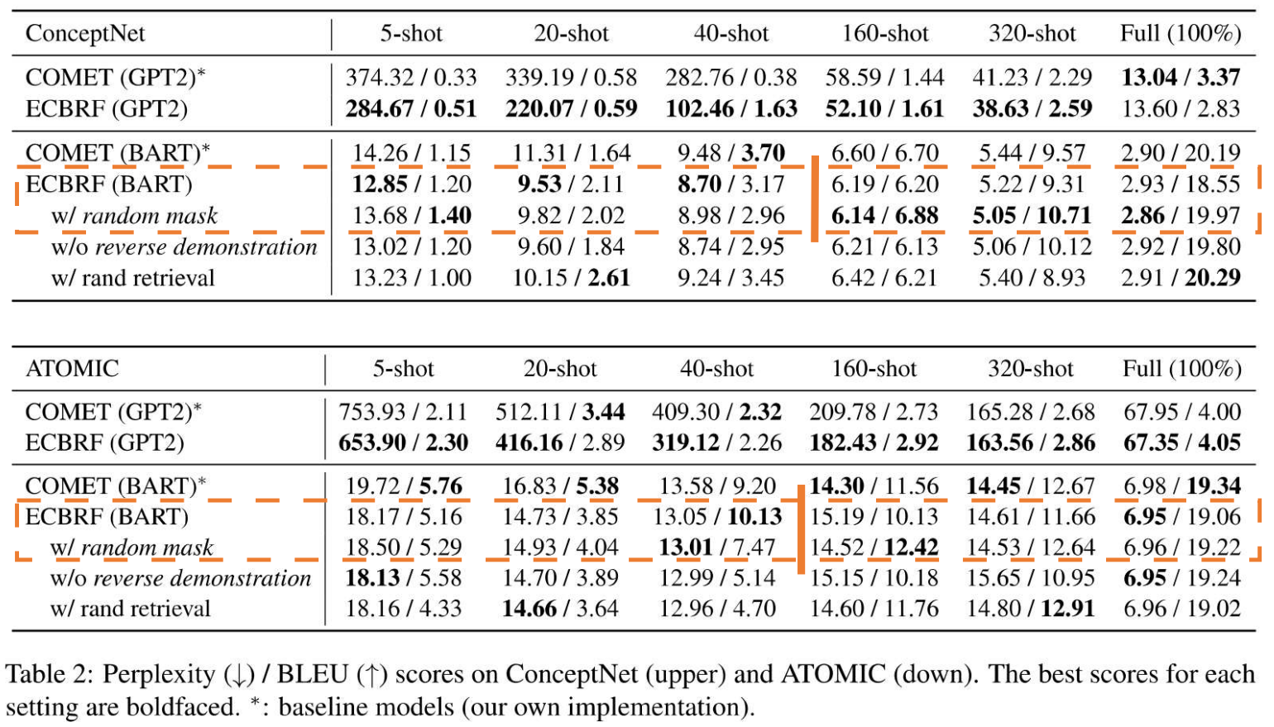

Benefits to NLP (2): Masking retrieved examples
$$random mask$$

Slide 8
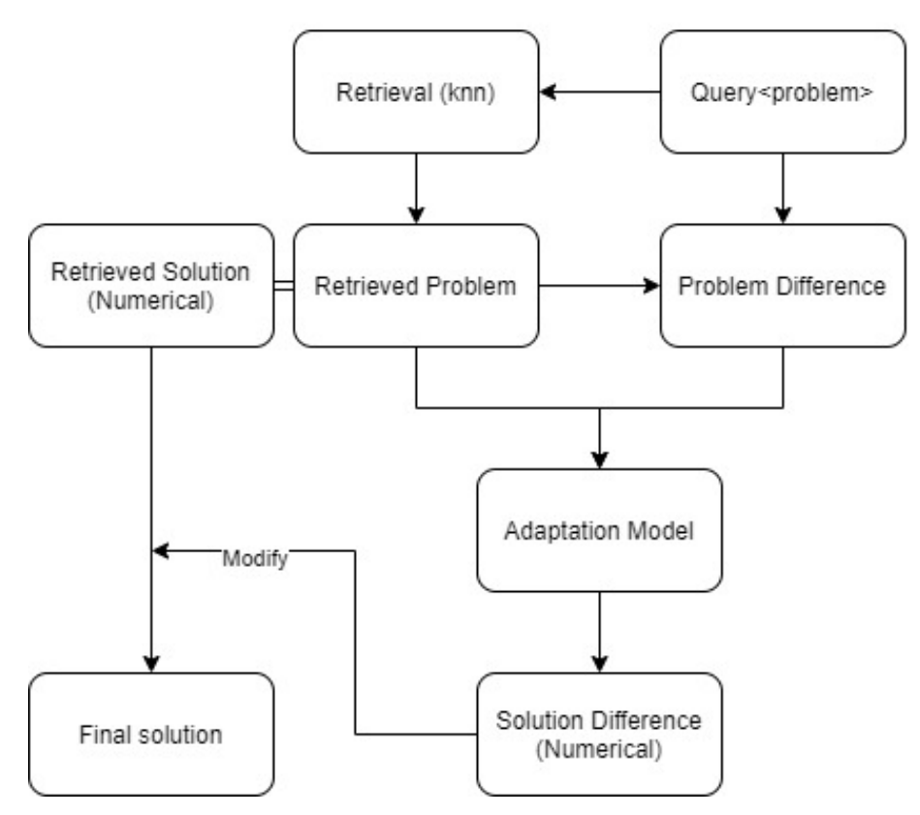
Benefits to case-based reasoning (1)
Whether the methodology of case-based reasoning is beneficial to the deep learning [1][2]
Could be beneficial to PLM
A typical CBR method in classic AI [3]

Slide 9
Benefits to case-based reasoning (2)
Challenging reuse step [4]
CBR methodology used as only a retriever
PLM for reuse step
Notes:
PLM might be able to perform the reuse step by giving the in-context examples

Slide 10
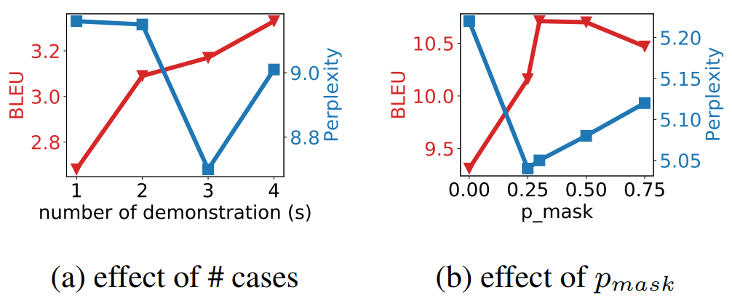

Other analyses
$$P_{mask}=30\%$$

Slide 11
Future works
Knowledge in case-based reasoning further development of in-context demonstrations
Advances in PLM development of case-based reasoning

Slide 12
Thank you!

Slide 13
References
[1] Leake, D. and Crandall, D., 2020. On bringing case-based reasoning methodology to deep learning. In Case-Based Reasoning Research and Development: 28th International Conference, ICCBR 2020, Salamanca, Spain, June 8–12, 2020, Proceedings 28 (pp. 343-348). Springer International Publishing.
[2] Ye, X., Leake, D. and Crandall, D., 2022, August. Case Adaptation with Neural Networks: Capabilities and Limitations. In Case-Based Reasoning Research and Development: 30th International Conference, ICCBR 2022, Nancy, France, September 12–15, 2022, Proceedings (pp. 143-158). Cham: Springer International Publishing.
[3] Ye, X., Leake, D., Jalali, V. and Crandall, D.J., 2021. Learning adaptations for case-based classification: A neural network approach. In Case-Based Reasoning Research and Development: 29th International Conference, ICCBR 2021, Salamanca, Spain, September 13–16, 2021, Proceedings 29 (pp. 279-293). Springer International Publishing.
[4] Choudhury, N. and Begum, S.A., 2016. A survey on case-based reasoning in medicine. International Journal of Advanced Computer Science and Applications, 7(8).

